Slide 1


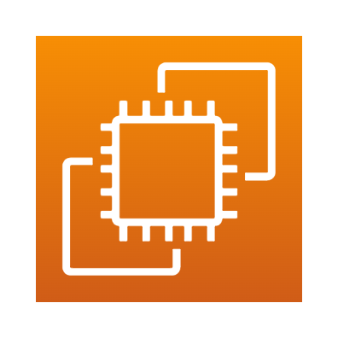



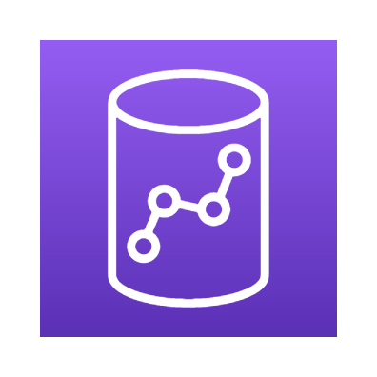

Guidance for Redshift DevOps On AWS – Open Source
Architecture To Build CI/CD pipeline for Redshift DevOps Using Open Source Services
1
A developer adds/modifies DDL (Data Definition Language) /DML (Data Modification Language) scripts in configuration files and commits them into GitHub for deployment.
GitHub commit triggers a webhook to start the build process on Jenkins. Declarative pipeline job in Jenkins is initiaited to start the build process.
Jenkins builds a docker container image using the configuration specified in the docker file. Once an image is built Jenkins job pushes the image to docker hub.
Jenkins job pulls the latest docker hub image and creates a new container, executes the DDL/DML scripts specified in the configuration file.
A docker container with latest image is executed to deploy the changes in multiple environments. Logs, test results in the docker container are saved to mapped ec2 directory.
Code executed in docker container checkpoints each executed step from config files and saves it in s3 bucket. In event of container restart, last saved checkpoint is used for execution.
Post validation of changes in TST environment, changes can be pushed to PROD environment.
2
3
AWS Cloud
3
ec2 Host
4
4
1
2
TST (Test Environment)
Jenkins Container
5
5
Developer
Git
Amazon Redshift
Redshift code deployment container
PROD (Production Environment)
6
7
6
Container for code build
Amazon Redshift
Amazon Redshift
7

Slide 2
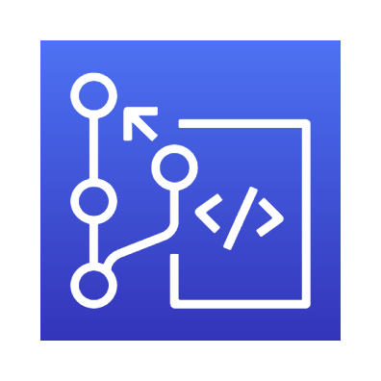
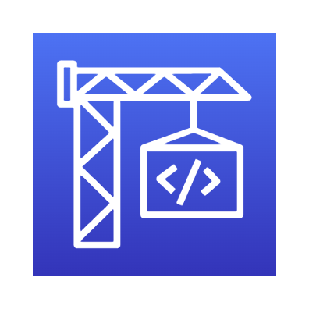
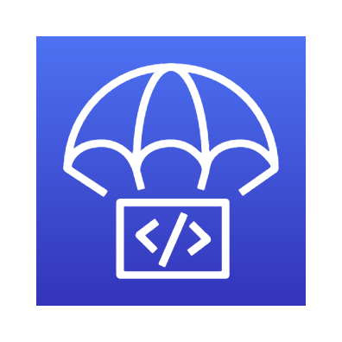

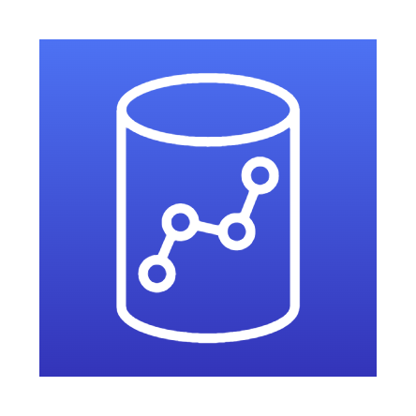
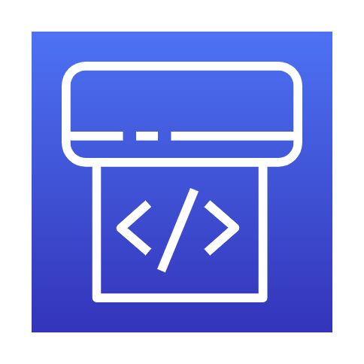


Guidance for DevOps for Redshift On AWS
Architecture To Build CI/CD pipeline for Redshift DevOps Using AWS Native Services
1
A developer adds/modifies DDL/DML scripts in configuration files and commits changes into AWS code commit .
2
AWS code commit triggers off a code build using configuration specified in buildspec.yml. The build happens based on pre_build, build and post_build command.
3
AWS code builds the container image and pushes it to AWS code deploy.
1
2
3
Amazon S3
4
Code deploy pushes the container image to Elastic container Registry (ECR) repository.
Developer
AWS Code Commit
AWS Code Build
AWS Code Deploy
5
EKS cluster extracts the latest image from ECR and deploys it as new cluster. A task is defined to run application code like a service.
4
6
5
Amazon Redshift Cluster - DEV
AWS Code Pipeline
7
EKS cluster picks up the container image, reads configuration in s3 bucket to determine execution step, connects with Redshift cluster and executes DDL/DML code.
6
Elastic Container Registry
Elastic Kubernetes Cluster
7
Code gets deployed in Redshift cluster environment, task completes and the deployment service waits for another change to DDL/DML script.
Amazon Redshift Cluster - TST

